Slide 1
Discrete Mathematics BCSC 0010 Group Theory

Slide 2
Groupoid or Binary Algebra
A finite or infinite set ‘S′ with a binary operation ‘ο′ (Composition) is called groupoid if it satisfied the closure condition.
Closure − For every pair (a,b)∈S,(aοb) has to be present in the set S.
Example
The set of N natural number with addition operation is a groupoid.
For example, N={1,2,3,…}
Here closure property holds as for every pair (a,b)∈N,
(a+b) is present in the set N. For example, 1+2=3∈N
Exp2: If we perform subtraction operation
1-2=-1, which is not belongs to N, so
The set of N natural number with subtraction operation is not a groupoid.

Slide 3
Semigroup
A finite or infinite set ‘S′ with a binary operation ‘ο′ (Composition) is called semigroup if it holds following two conditions simultaneously −
Closure − For every pair (a,b)∈S,(aοb) has to be present in the set S.
Associative − For every element a,b,c∈S,(aοb)οc=aο(bοc) must hold.
Example
The set of positive integers (excluding zero) with addition operation is a semigroup.
For example, S={1,2,3,…}
Here closure property holds as for every pair (a,b)∈S,(a+b) is present in the set S. For example, 1+2=3∈S
Associative property also holds for every element a,b,c∈S,(a+b)+c=a+(b+c). For example, (1+2)+3=1+(2+3)=5

Slide 4
Monoid
monoid is a semigroup with an identity element.
The identity element (denoted by e or E) of a set S is an element such that (aοe)=a, for every element a∈S.
An identity element is also called a unit element.
So, a monoid holds three properties simultaneously − Closure, Associative, Identity element.

Slide 5
Monoid
Example
The set of positive integers with multiplication operation is a monoid.
S={1,2,3,…}
(1) Here closure property holds as for every pair (a,b)∈S,(a×b) is present in the set S. [For example, 1×2=2∈S and so on]
(2) Associative property also holds for every element a,b,c∈S,(a×b)×c=a×(b×c)
[For example, (1×2)×3=1×(2×3)=6 and so on]
(3) Identity property also holds for every element a∈S,(a×e)=a
[For example, (2×1)=2,(3×1)=3 and so on]. Here identity element is 1.
[For example, (2+0)=2,(3+0)=3 and so on]. Here identity element is 0.

Slide 6
Group
A group is a monoid with an inverse element.
The inverse element (denoted by I) of a set S is an element such that
(a ο a^-1)= 1, or (a ο -a)= 0, for each element a, 1/a, -a∈S.
So, a group holds four properties simultaneously –
Closure, ii) Associative, iii) Identity element, iv) Inverse element.
The set of positive integers with multiplication operation is not a group.
S={1,2,3,…}
Inverse element.
For a set of integers addition operation is satisfied inverse element
1. Exp: 2+__=0, -2
Where 2 and -2 both belongs to set of integer.
2. Exp: 2*__=1, 1/2
Where 1/2 is not belongs to set of integer. (so it is not inverse element)

Slide 7
Group
A group is a monoid with an inverse element.
The inverse element (denoted by I) of a set S is an element such that (aοI)=(Iοa)=a, for each element a∈S.
So, a group holds four properties simultaneously –
Closure, ii) Associative, iii) Identity element, iv) Inverse element.
Example check for group
Set of natural number
Set of integer having addition set.
Set of integer having multiplication set.
Set of real number having multiplication, addition set.

Slide 8
Group
A group is a monoid with an inverse element.
The inverse element (denoted by I) of a set S is an element such that (aοI)=(Iοa)=a, for each element a∈S.
So, a group holds four properties simultaneously –
Closure, ii) Associative, iii) Identity element, iv) Inverse element.
Example check for group
Set of natural number (1, 2, 3(multiplicative), 4 not possible)- not group
Set of integer having addition set (group)
Set of integer having multiplication set (inverse element not exp= 1/4) not group
Set of real number having multiplication, addition set (yes It is group)

Slide 9
Abelian Group
An abelian group G is a group for which the element pair (a,b)∈G always holds commutative law.
So, a group holds five properties simultaneously - i) Closure, ii) Associative, iii) Identity element, iv) Inverse element, v) Commutative.
Example: Set of real number having multiplication, addition set is an abelian group
1+2=3∈S
(1+2)+3=1+(2+3)=6
(2+0)=2, (3+0)=3
(2-2)=0, (3-3)=0
1+2=2+1

Slide 10
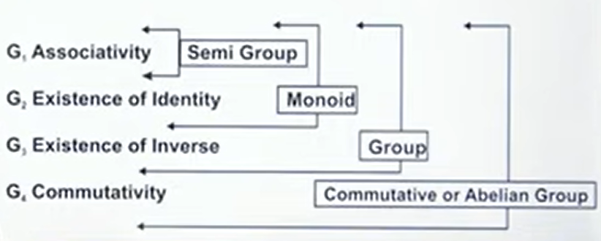
Abelian Group

Slide 11
Abelian Group
Qs. Show that the set of integers forms an abelian group under addition.
Ans: An Abelian group holds five properties simultaneously –
Closure, ii) Associative, iii) Identity element, iv) Inverse element, v) Commutative.
Let the set is G = {---- -b,-a,0,a,b--------}

Slide 12
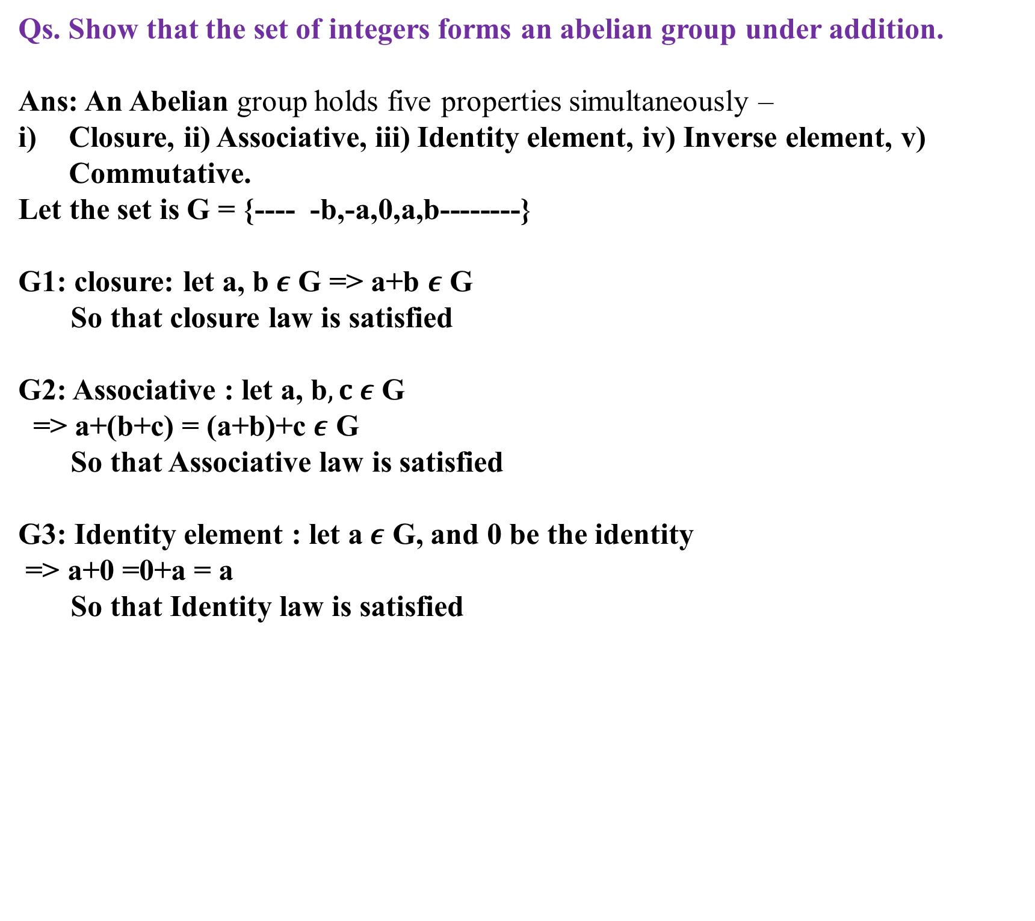
Abelian Group
Qs. Show that the set of integers forms an abelian group under addition.
Ans: An Abelian group holds five properties simultaneously –
Closure, ii) Associative, iii) Identity element, iv) Inverse element, v) Commutative.
Let the set is G = {---- -b,-a,0,a,b--------}
G1: closure: let a, b$ε$ G => a+b $ε$ G
So that closure law is satisfied
G2: Associative : let a, b$, c ε$ G
=> a+(b+c) = (a+b)+c $ε$ G
So that Associative law is satisfied
G3: Identity element : let a$ε$ G, and 0 be the identity
=> a+0 =0+a = a
So that Identity law is satisfied

Slide 13
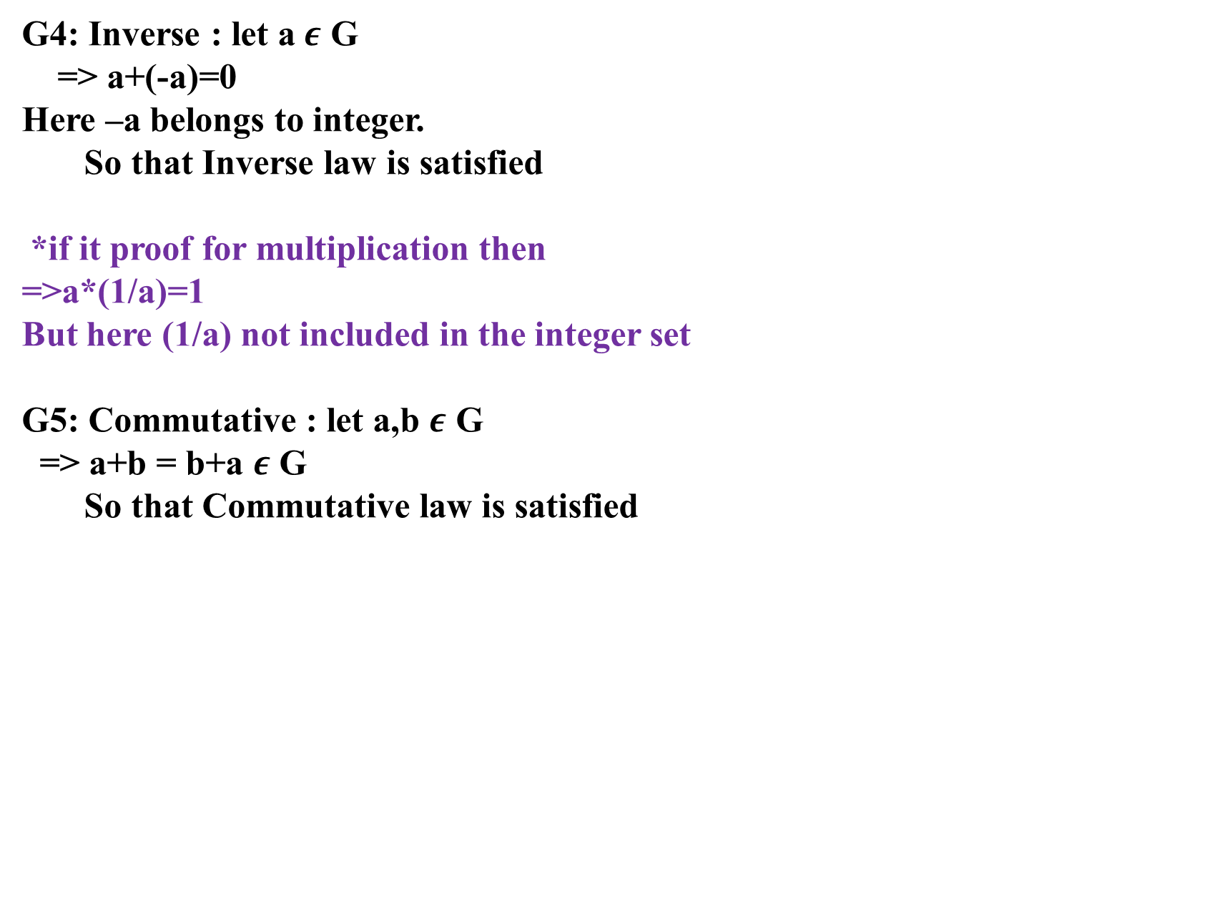
Abelian Group
G4: Inverse : let a$ε$ G
=> a+(-a)=0
Here –a belongs to integer.
So that Inverse law is satisfied
*if it proof for multiplication then
=>a*(1/a)=1
But here (1/a) not included in the integer set
G5: Commutative : let a,b $ε$ G
=> a+b = b+a $ε$ G
So that Commutative law is satisfied

Slide 14
Group
Qs. G is a set of rational except -1, and the operation ”*” is define by
(a*b= a+b+ab), show it is a group.
Ans: An group holds four properties simultaneously –
Closure, ii) Associative, iii) Identity element, iv) Inverse element
Let the set

Slide 15
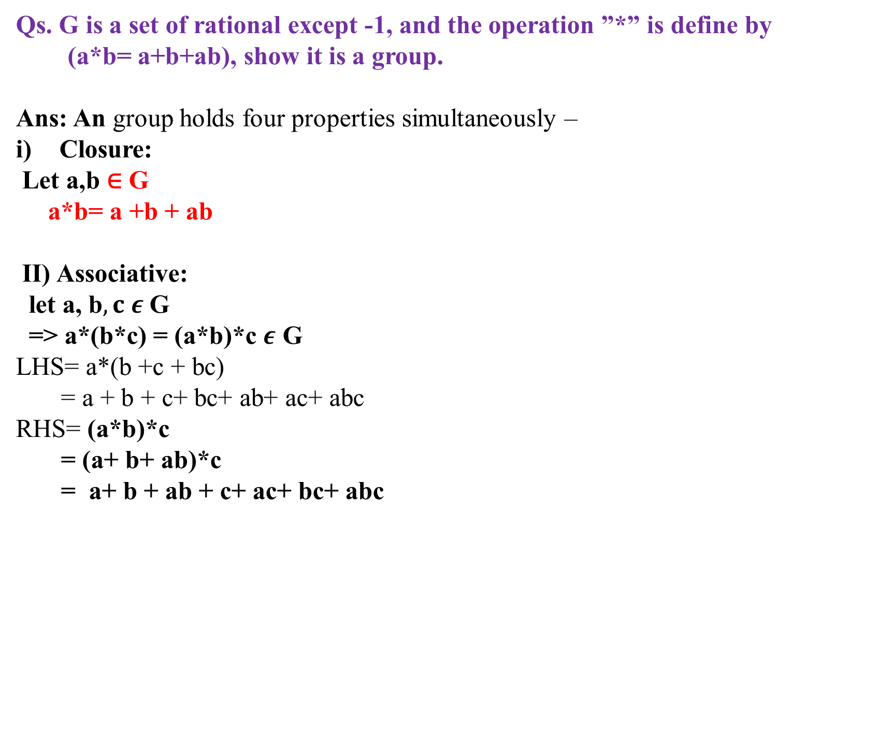
Group
Qs. G is a set of rational except -1, and the operation ”*” is define by
(a*b= a+b+ab), show it is a group.
Ans: An group holds four properties simultaneously –
Closure:
Let a,b ∈ G
a*b= a +b + ab
II) Associative:
let a, b$, c ε$ G
=> a*(b*c) = (a*b)*c $ε$ G
LHS= a*(b +c + bc)
= a + b + c+ bc+ ab+ ac+ abc
RHS= (a*b)*c
= (a+ b+ ab)*c
= a+ b + ab + c+ ac+ bc+ abc

Slide 16
Group
Qs. G is a set of rational except -1, and the operation ”*” is define by
(a*b= a+b+ab), show it is a group.
Ans: An group holds four properties simultaneously –
(iii) Identity :
Let a ∈ G
Multiplication is there a* e= a
a*e= a +e + ae=a
e+ ae=0
e(1+a)=0
e=0 or a=-1 (which is not possible as given in question)
So identity element e=0

Slide 17
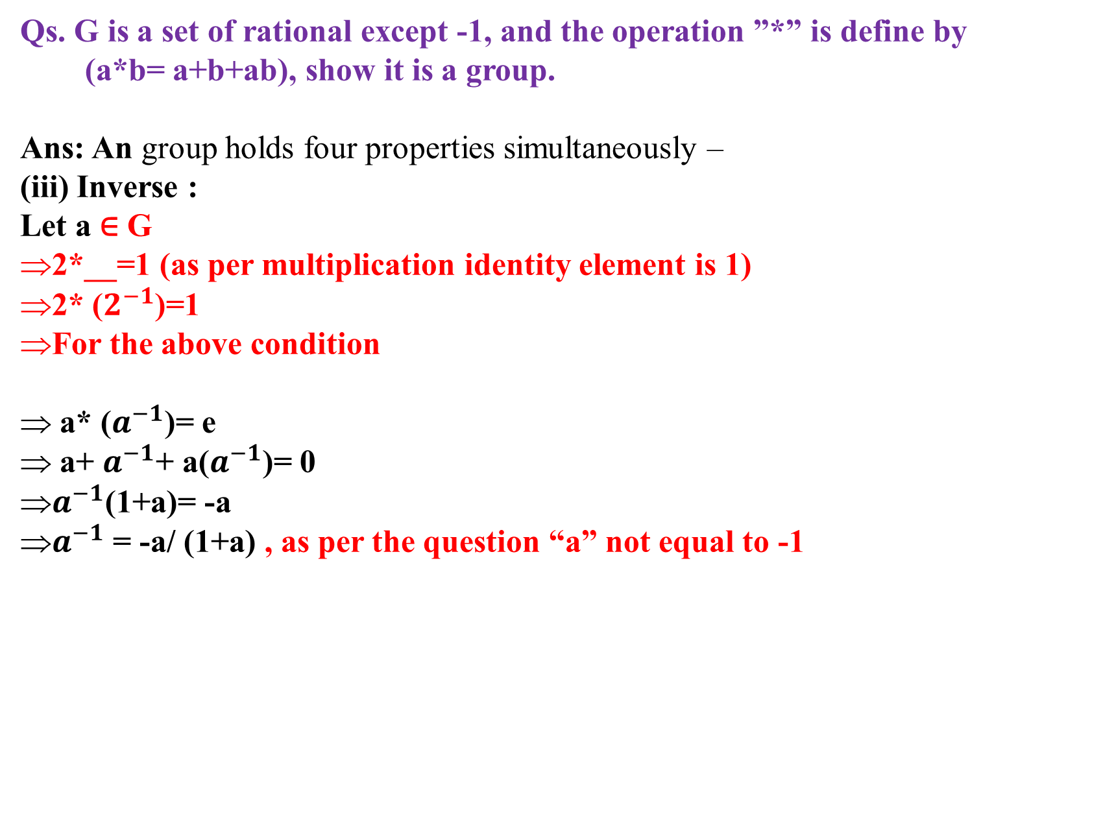
Group
Qs. G is a set of rational except -1, and the operation ”*” is define by
(a*b= a+b+ab), show it is a group.
Ans: An group holds four properties simultaneously –
(iii) Inverse :
Let a ∈ G
2*__=1 (as per multiplication identity element is 1)
2* ($2^{−1}$)=1
For the above condition
a* ($a^{−1}$)= e
a+ $a^{−1}$+ a($a^{−1}$)= 0
$a^{−1}$(1+a)= -a
$a^{−1}$ = -a/ (1+a) , as per the question “a” not equal to -1

